Slide 1


Project name: Remote Thermal Viewing within High Voltage Team members: Blake Bagley, Julia Garcia, Erica Mathew

Slide 2
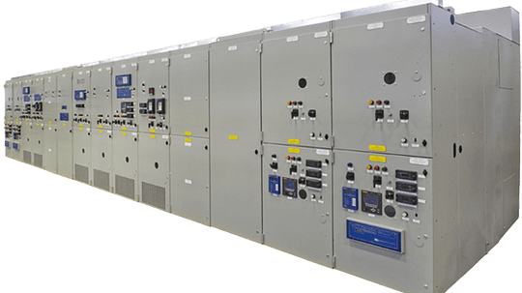

Project description
Problem statement: “As industry demand grows, space inside medium voltage switchgear has become increasingly limited. Manufacturers are required to fit more devices and wires within the same limited space. Additionally, manufacturers are now being asked to include a remote viewing system within the switchgear to monitor a physical ground switch. This ground switch is physically blocked, by wires, from the view of the operator.”
Notes:
Erica: Our project sponsor is powell industries which is a “Powell Industries designs and manufactures equipment like switchgear, circuit breakers, and power management systems that help safely control and distribute electrical power in multiple different industries
Switchgears are Switchgears are devices that control and protect electrical circuits by turning power on or off and preventing damage during electrical faults.
Powell industries designs/maufactures
explain switchgears
explain project

Slide 3
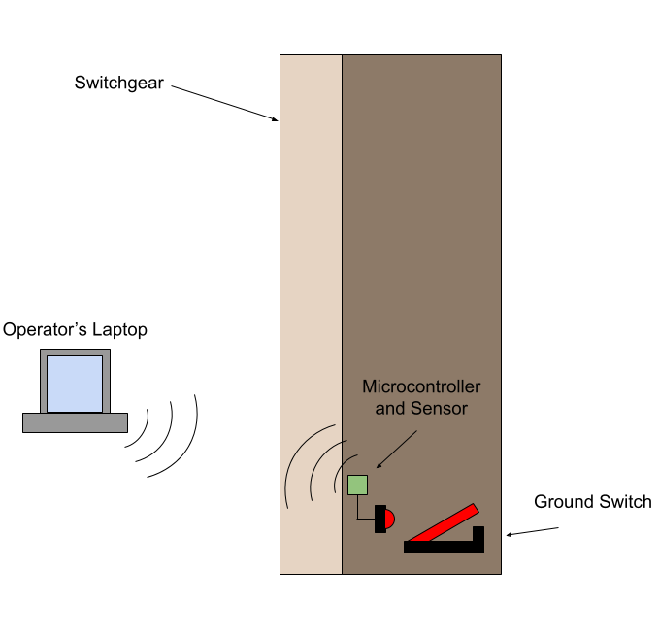
Project Solution Description
Solution proposal: Our solution to this problem is to create a thermal remote viewing system that an operator can connect to through Wi-Fi, allowing for operators to confirm the grounding switch is either open or closed through video and automation. This will make switchgear operators jobs safer and more convenient.
Notes:
Blake

Slide 4
System Overview
Power Supply
Thermal Sensor
Battery
Website
Converters
Microcontroller
Julia, Blake, Erica
Notes:
Julia: Design the power supply and overall hardware of the system.
Blake: Microcontroller coding and ML
Erica: Creating Web Application for users to interact with

Slide 5
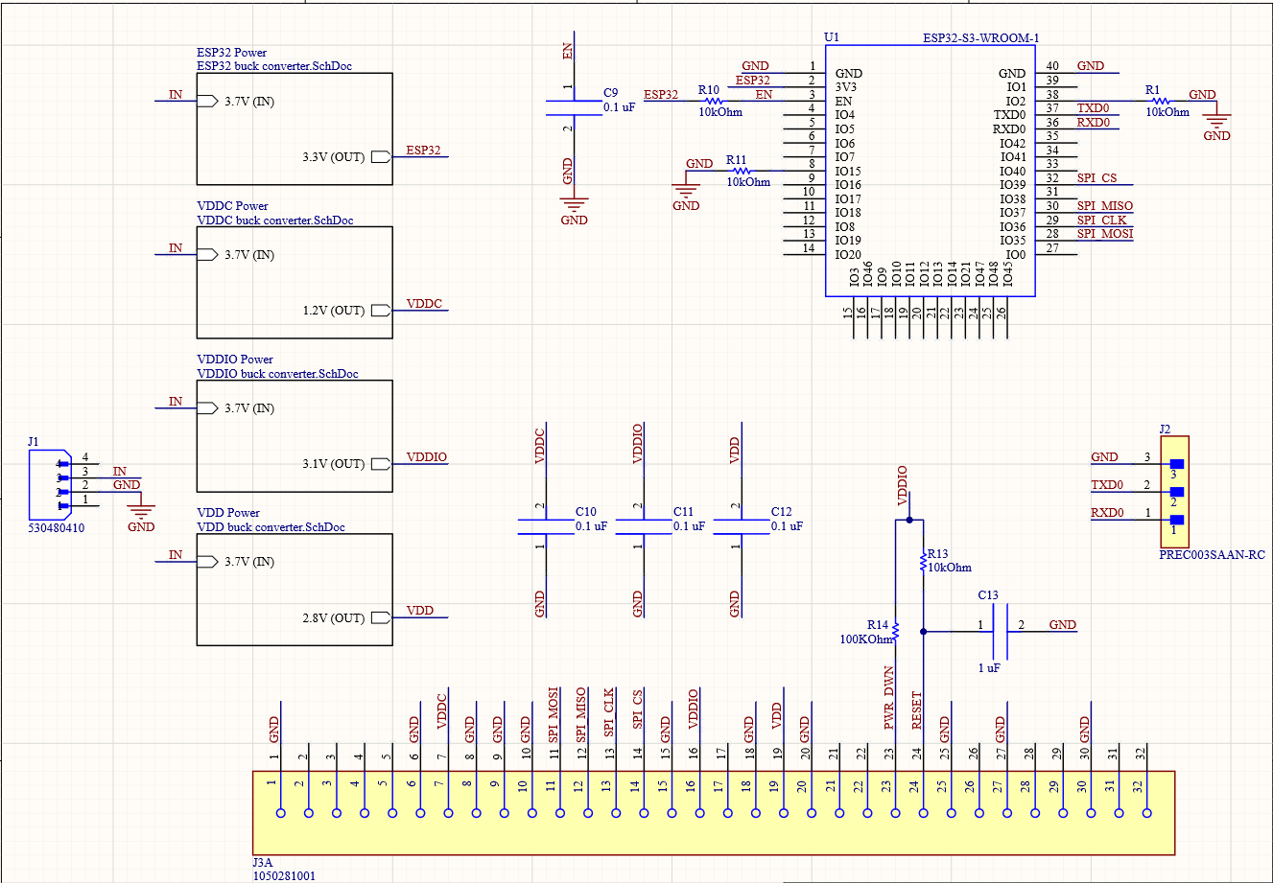
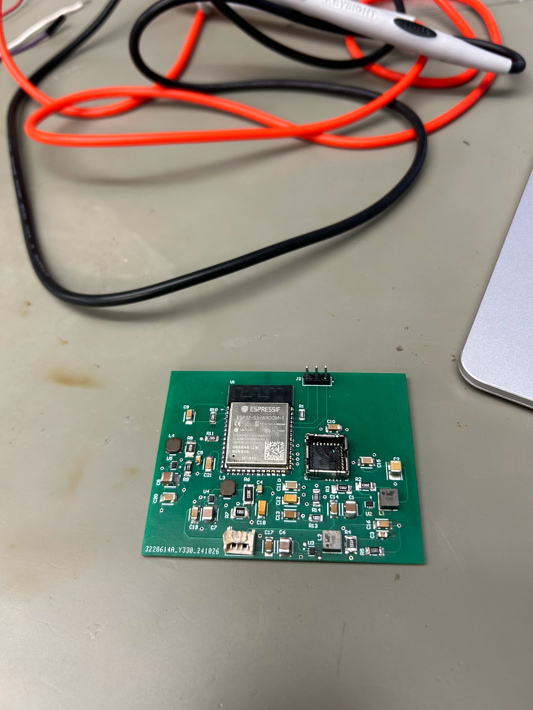
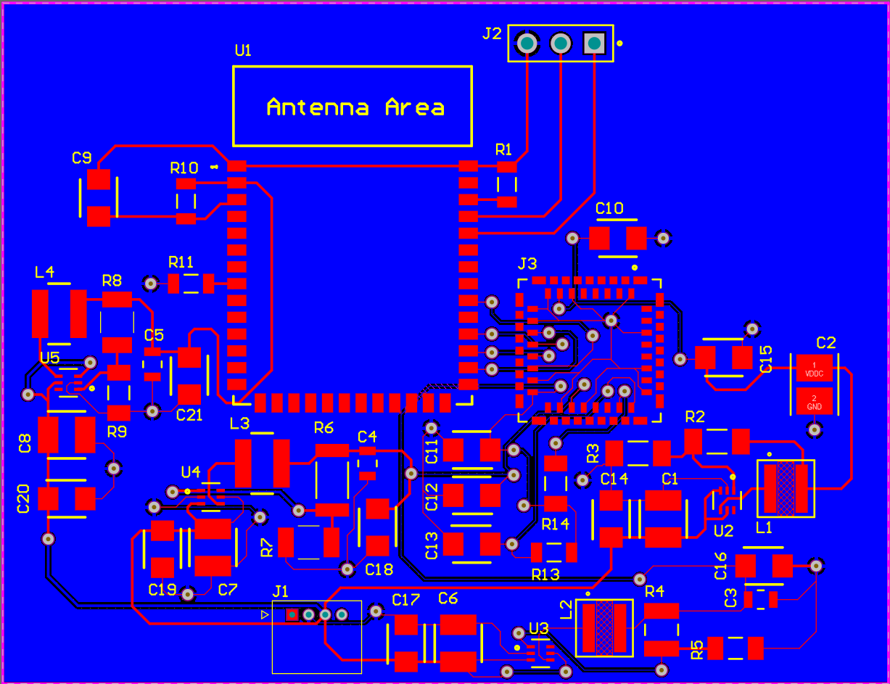
Thermal Sensor/PCB (Julia)
Completed -
Entire PCB design
4 individual buck converter designs
Simulated all designs on WEBench
Designed schematic
created necessary footprints
Routed the board
Soldered the board
Problems
2 buck converter don’t output correct values
1 converter is ~0.2 V off
1 converter ~3 V off
Battery died during testing
404 Plans
Improve board if needed
Help with camera integration

Slide 6
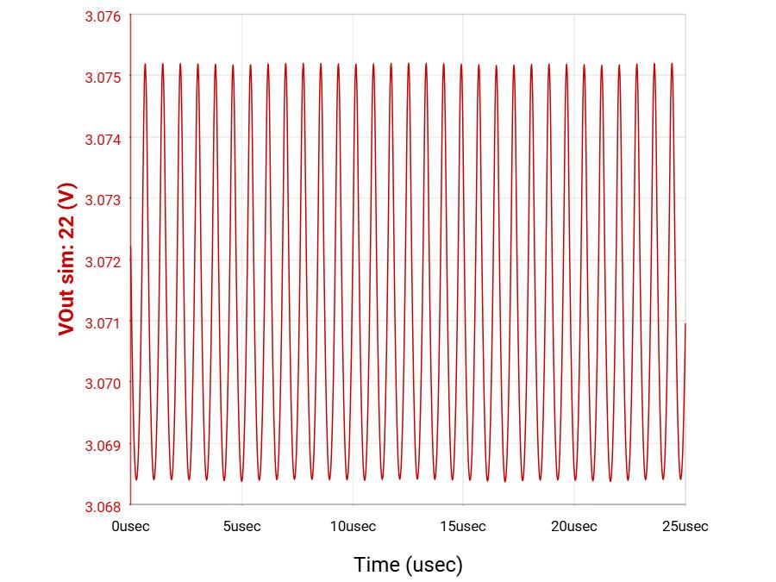
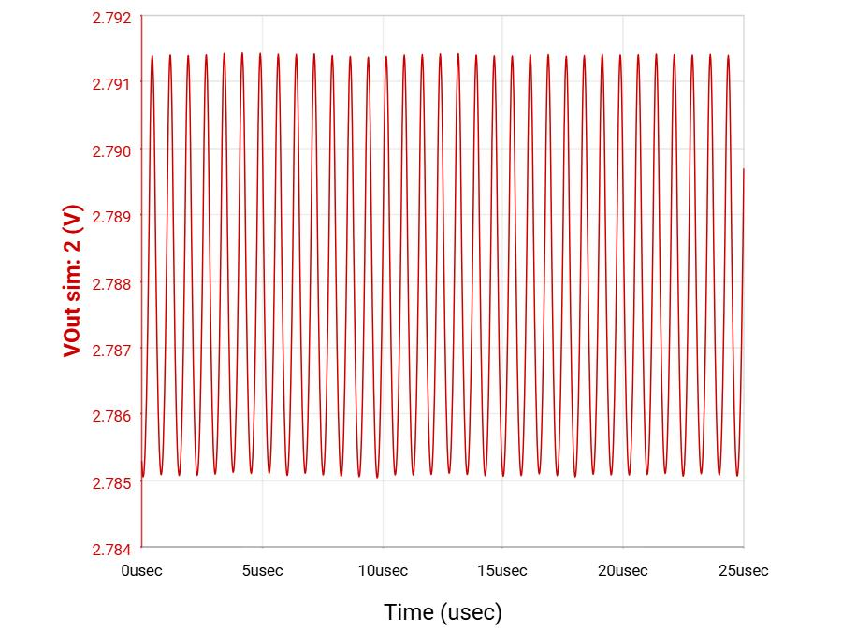
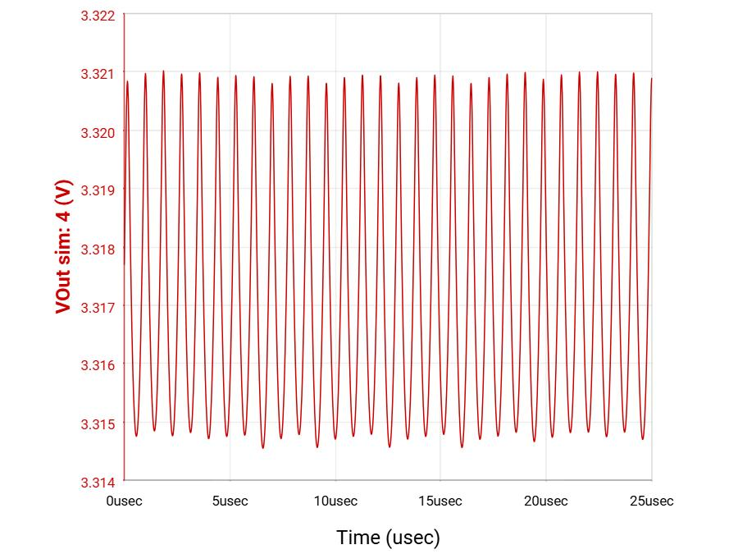
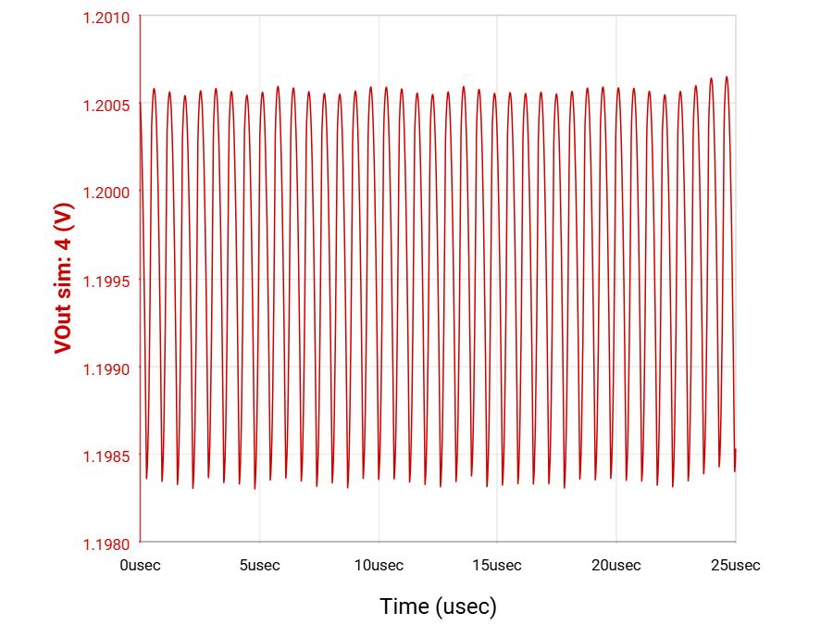
Thermal Sensor/PCB (Julia)
VDDIO
VDD
ESP32
VDDC

Slide 7
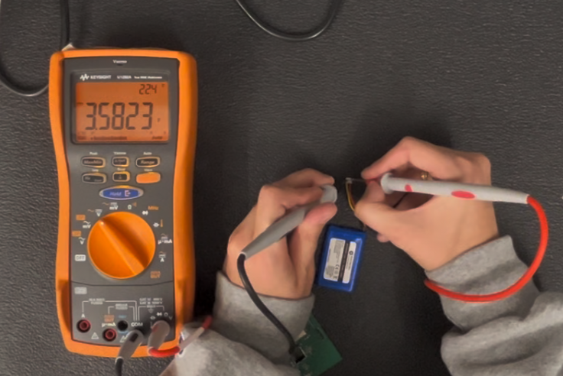
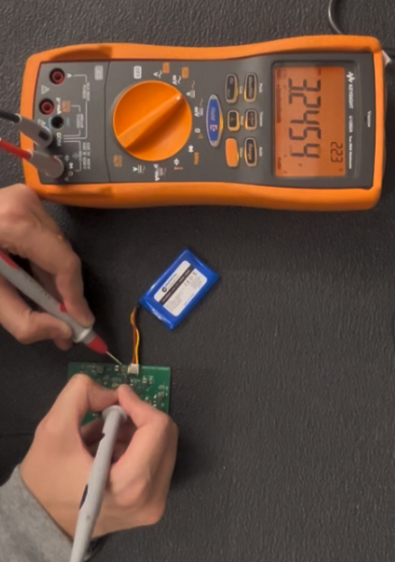
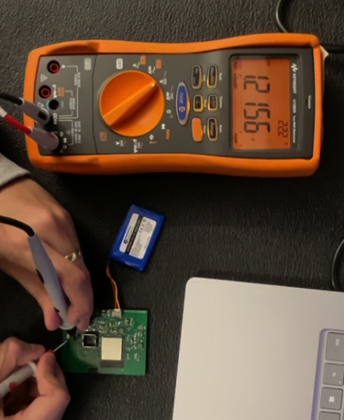
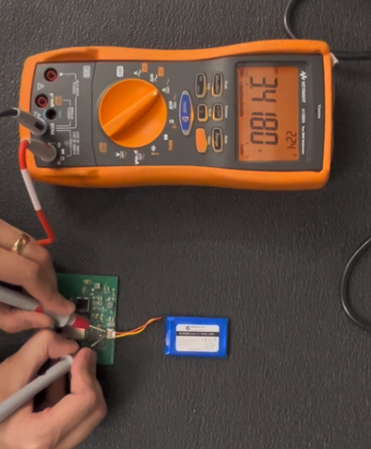
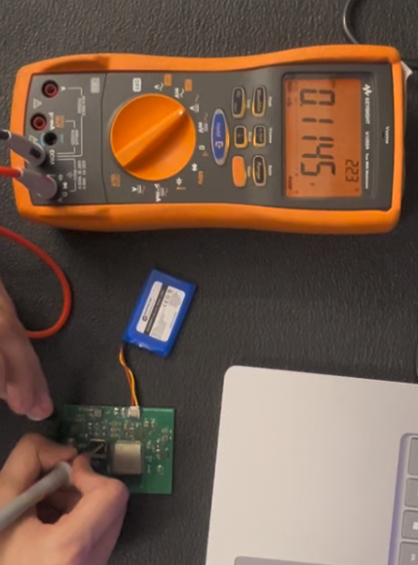
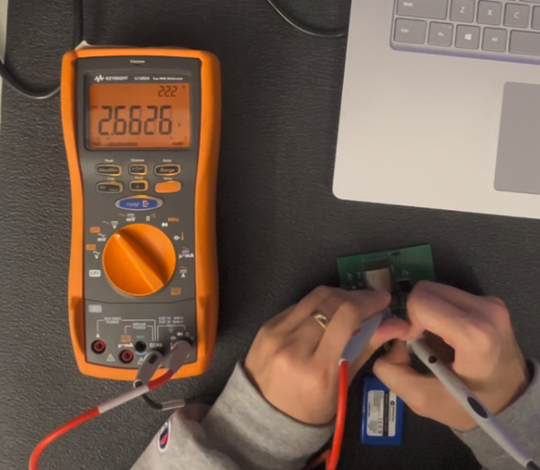
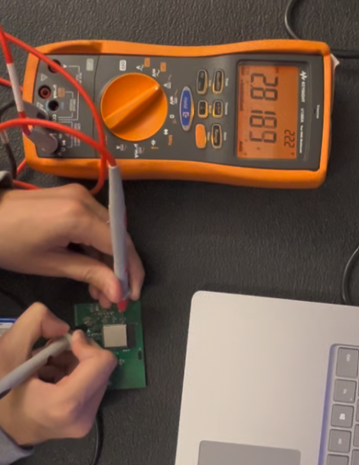
Thermal Sensor/PCB (Julia)
Battery Unplugged
nominal voltage ~3.7 V
Input Tested on Components
nominal voltage ~3.7 V
Output #2 Voltage to VDDC
Expected output ~1.2 V
Battery Plugged In
nominal voltage ~3.7 V
Output #1 Voltage to VDDIO
Expected output ~3.1 V
Output #3 Voltage to VDD
Expected output ~2.8 V
Output #4 Voltage to VDD
Expected output ~3.3 V

Slide 8
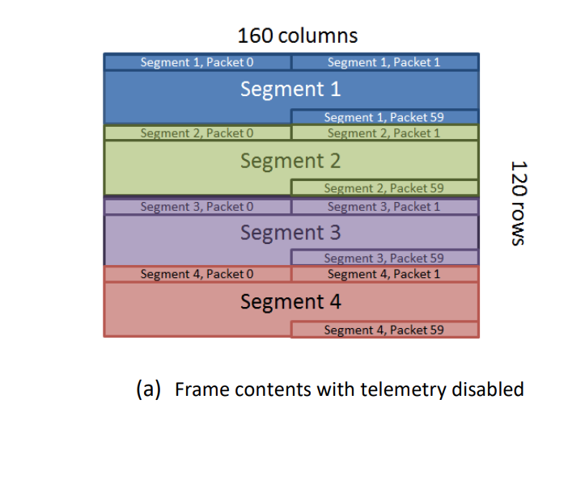
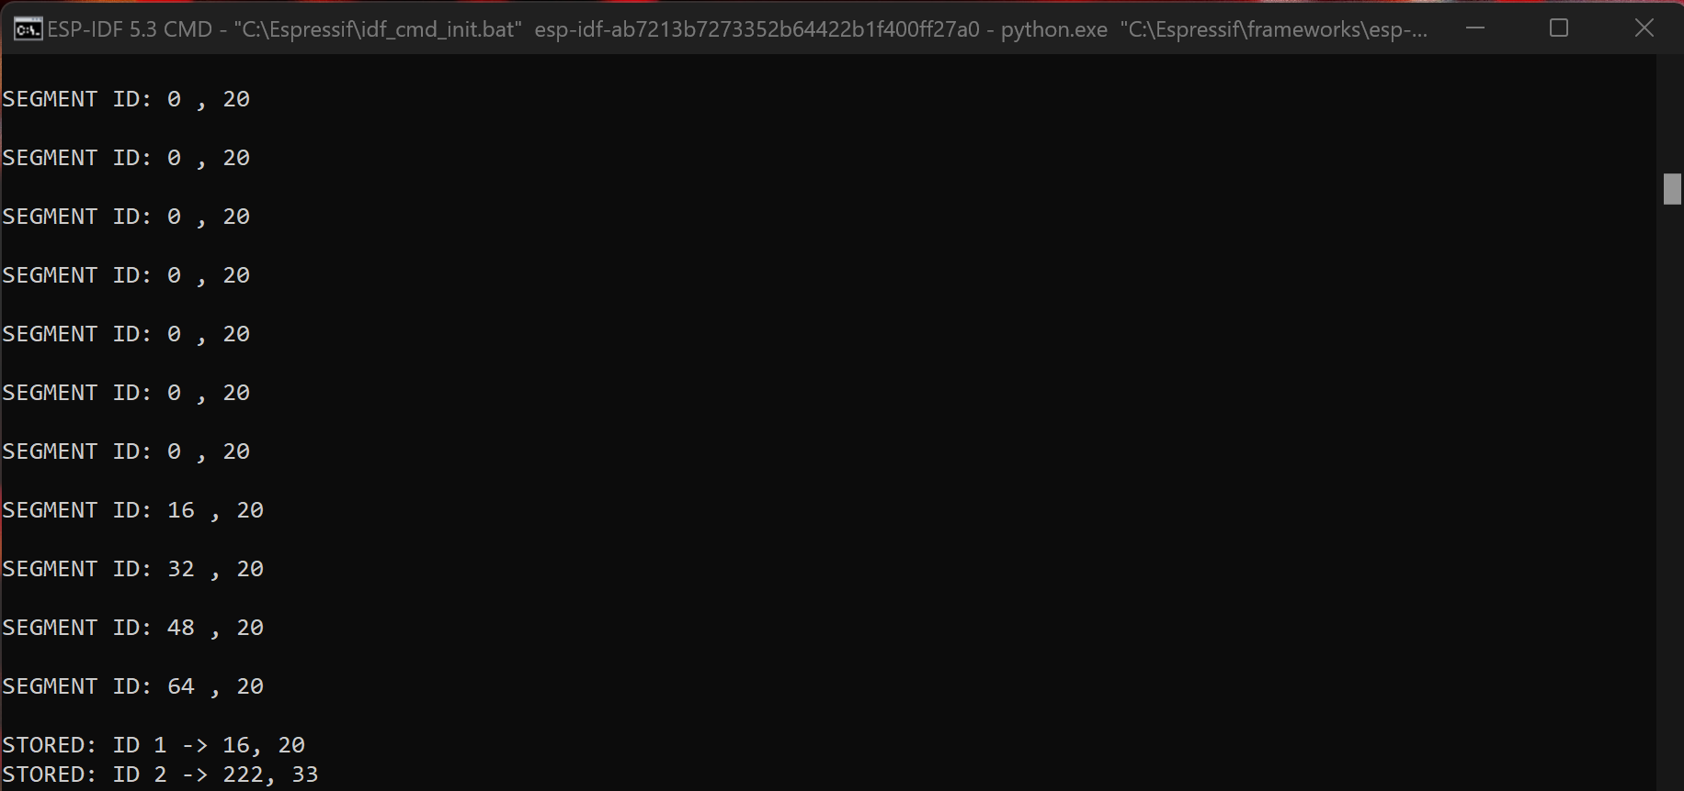
Microcontroller (Blake)
Receiving Camera Data
Each segment has 60 packets with a packet ID from 0-59
Each segment has a segment ID on 20th packet from 1-4
Figure taken from FLiR Lepton Datasheet
Problems
Rarely, the camera will get to a point on never reading a good segment.

Slide 9
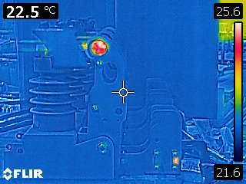
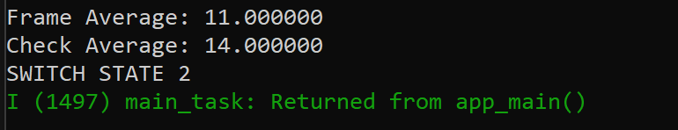
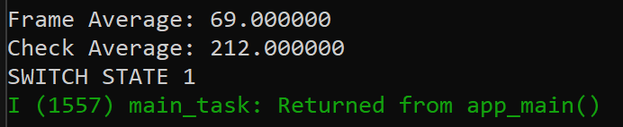
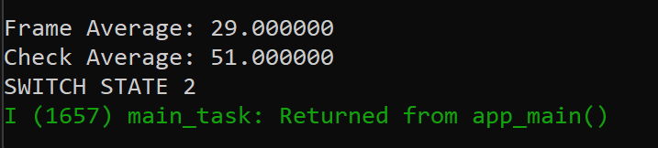
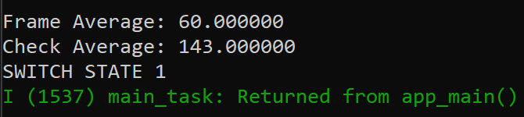
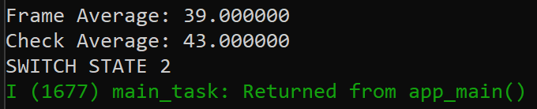
Microcontroller (Blake)
Image Processing
I first normalize the pixel data to an 8-bit mapping (0-255)
Calculate the difference between the average heat of the frame and the designated window
Nothing in frame
Heat in top half
Heat in bottom half
Heat in left half
Problems
Figuring out how to upload photos to microcontroller to validate image processing.
Heat in right half

Slide 10
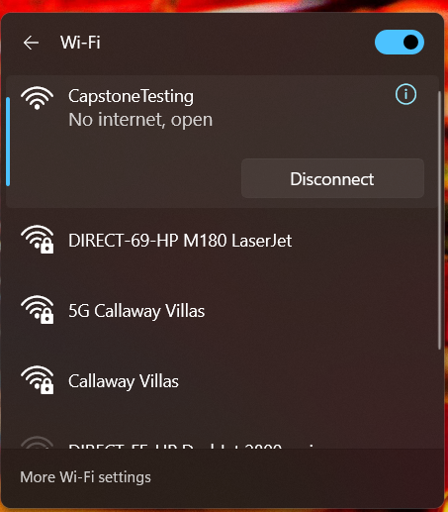
Microcontroller (Blake)
WiFi Connection
The microcontroller is set up a the moment as an access point and scans for devices that can connect to it. The SSID of it is set to “CapstoneTesting” which I can verify through my laptop's WiFi.

Slide 11

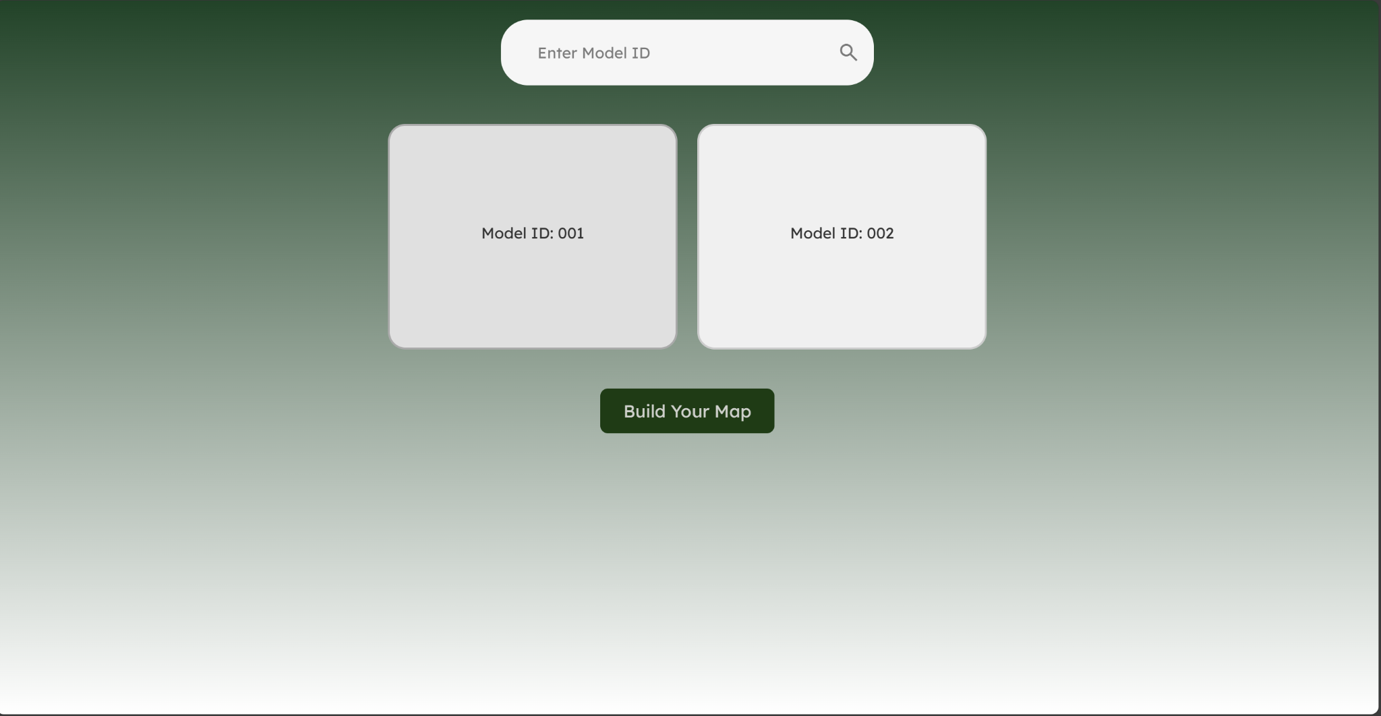
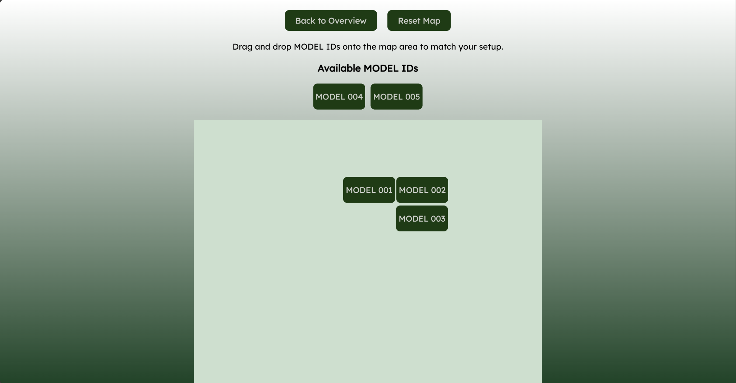
Web Application (Erica)
Completed:
Login and Registration Pages
Firebase Authentication
Overview page that displays multiple video stream thumbnails
Search bar to navigate to a specific video stream
Created Buildable Map for users to match their switchgear setup

Slide 12
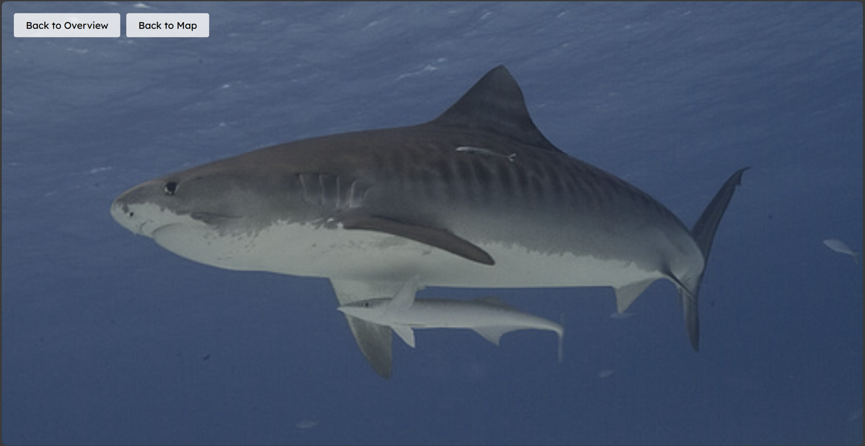
Web Application (Erica)
Completed:
Created websocket server using Node.js to send images to website at regular intervals
Website reads from 1000 image zip file, displaying them one after another
404 Plans:
Publish site
Integrate with microcontroller to display real time image frames from thermal sensor
Notes:
We chose RTMP/embedding streams because it allows us to easily integrate live streaming without needing to deal with the complexity of setting up RTMP directly. Platforms like YouTube Live already use RTMP behind the scenes, so we can embed their stream with minimal effort.
WebRTC is great for real-time communication, but it's too complicated to set up using plain JavaScript, especially for streaming.
WebSockets can handle data streams, but we found it has too many bugs and lacks reliable tools for streaming video efficiently.
im now embedding a livestream from youtube live

Slide 13
Execution plan
 | 9/16/24 | 9/23/24 | 9/30/24 | 10/6/24 | 10/13/24 | 10/20/24 | 10/27/24 | 11/4/24 | 11/11/24 | 11/18/24 | 11/25/24 | 12/5/24
Work on Documentation
Project Parts Ordered
Subsystem Introduction Project |  |  |  |  |  |  |  |  | Not Started
Web Application Structure + set up Firebase |  |  |  |  |  |  |  |  | In Progress
Finalize PCB Block Diagram |  |  |  |  |  |  |  |  | Completed
Design Login page |  |  |  |  |  |  |  |  | Behind
Midterm Presentation
Buck Converter Design + Simulation
Initial PCB Designed and ordered
Build Homepage that displays live video
Initial PCB Received
Switch-State Detection complete
Implement backend for fetching video feeds
Status Update Presentation
Initial PCB Complete
Microcontroller WiFi
Camera Data Receiving Complete
Switch Data Examples for Processing
Image Processing Complete
Added website features for user convenience
Final PCB Complete
Final Presentation
Subsystem Demo
Final Report

Slide 14
Validation Plan
Paragraph # | Test Name | Success Criteria | Methodology | STATUS | Engineers
3.2.3.1.2 | Provide Power | Input Voltage reads ~3.7 V, Microcontroller receives voltage, Sensor input VDD receives voltage | Use multimeter to input voltages | PASS | Julia Garcia
3.2.3.1.2 | Buck Converters | Output to VDDC reads ~1.26 V, Output to VDD reads ~2.88 V, Output to VDDIO reads ~3.1 V, Output to ESP32 reads ~3.3 V | Use multimeter to measure the output voltages | FAIL | Julia Garcia
3.2.3.2.2 | Sensor Sending Video | Signal is going from the output of the thermal sensor and into the input of the microcontroller | Use a oscilloscope to prove signal is present | UNTESTED | Julia Garcia
3.2.1.2 | Switch-State Determination Accuracy | Make sure the accuracy of the Switch-State Determination is up to standard | Use photos of the switch in different states | PASS | Blake Bagley
3.2.3.2.2 | Receiving Video from Sensor | Video is being received from the camera through the VSPI pins | Checking packet and segment IDs coming in | PASS | Blake Bagley
3.2.1.1 | Connection to WiFi | If the ESP32 can make a WiFi connection as an access point or as a station | Searching for ESP32 SSID on a personal laptop. | PASS | Blake Bagley
3.2.1.1 | Sending Video to Website | The ESP32 is able to send an image over WiFi | Have the ESP32 send a video to a personal laptop | UNTESTED | Blake Bagley
3.2.1.4 | Receiving Video | If no video stream is displayed on website, an error message should be outputted to screen. Video should be of correct vertical tower | Confirm the correct file is linked to its respective MODEL ID (either 001 or 002). 003-005 should display error message. | PASS | Erica Mathew
3.2.1.1 | Login-in System | Login with correct credentials and fail with incorrect credentials | Have user create different login credentials to check if they are stored in firebase | PASS | Erica Mathew
3.2.1.1 | Search Bar | Search bar redirects user to the proper video stream | Have user type different ID numbers to test search bar functionality | PASS | Erica Mathew
3.2.1.4 | Video Display Page | Overview Page that displays multiple video streams. Video streams in overview page are clickable to redirect user to zoomed in video feed on a different page | Send different video live streams and have user try to access all of them | PASS | Erica Mathew

Slide 15
Remaining Tasks
Needs to be completed by demo:
Validating Image Processing
Need to continue debugging VDDIO buck converter
404 Plans:
Integrate microcontroller and website to send live data from thermal sensor

